Slide 1

ZOMATO
Punkit Verma
(14-AUG-2024)

Slide 2
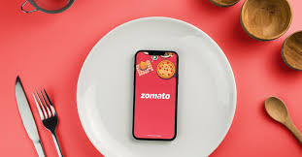
ABOUT ZOMATO
Zomato was founded by Deepinder Goyal and Pankaj Chaddah in 2008.
Zomato is an Indian multinational restaurant aggregator and food delivery company.
Zomato provides information, menus, user reviews of restaurants, and food delivery options from partner restaurants in more than 1,000 Indian cities and towns, as of 2022–23.

Slide 3

PROJECT AIM
Financial Objective:
To enhance financial growth by increasing funds and revenue streams, ensuring long-term profitability.
Marketing Objective:
To expand the customer base globally by tapping into new markets and fostering brand awareness worldwide.
Growth Objective:
To drive continuous growth by expanding the customer base, increasing user engagement, and boosting page traffic.
Globalization Objective:
Expanding operations across international markets to establish a global presence as a leading service provider.

Slide 4
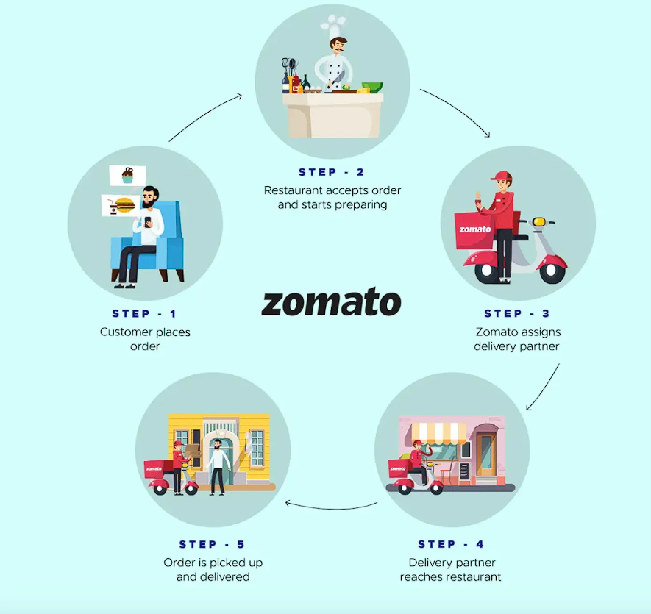
HOW ZOMATO WORKS ?

Slide 5

DATA OVERVIEW
Total Number of Restaurants:
Zomato offers a diverse range of 9,551 restaurants, featuring various cuisines such as North Indian, Chinese, Bakery, Tea, and more.
Opening Year of Restaurants:
The most restaurants opened in 2011, while the fewest were established in 2012.
Geographical Coverage:
Zomato's restaurant services extend to 15 countries worldwide, showcasing its significant global presence and reach.

Slide 6
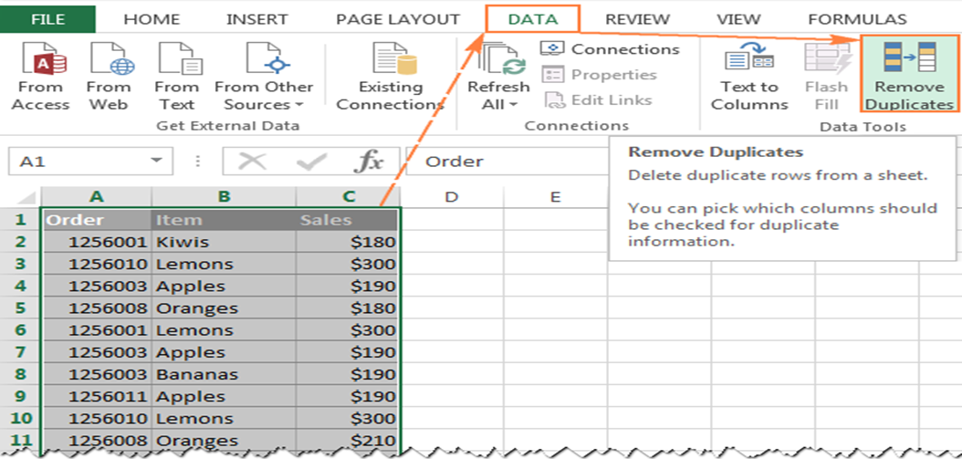
DATA CLEANING
Handling Null Values:
Null values in the Longitude, Latitude, and Votes columns have been replaced with their respective average values to ensure data completeness.
Cuisines Data Correction:
9 blank cells in the Cuisines column were filled with appropriate cuisine types based on their country codes.
Currency Update:
All currency values have been converted to Indian Rupees (INR), and the updated values are stored in a new column named Currency_Updated.
Year Extraction:
The Year has been extracted from the Datekey_Opening column to enable time-based analysis.
Data Formatting:
The dataset is organized and well-maintained using wrap text, borders, and bold formatting to enhance readability and presentation.

Slide 7

ANALYTICAL APPROACH AND TOOLS
Data Cleaning:
Utilized functions such as FIND and REPLACE, CLEAN, and TRIM to ensure data accuracy and consistency by removing unwanted characters, spaces, and errors.
Data Enrichment:
Enhanced the dataset by integrating additional variables using VLOOKUP, and cross-referencing with external data sources to provide a more comprehensive analysis.
Descriptive Analysis:
Employed Pivot Tables to summarize key metrics, uncover trends, and identify patterns related to restaurant openings and ratings.
Visualization:
Created dynamic charts and dashboards to visually represent the data, facilitating insights and better decision-making.

Slide 8
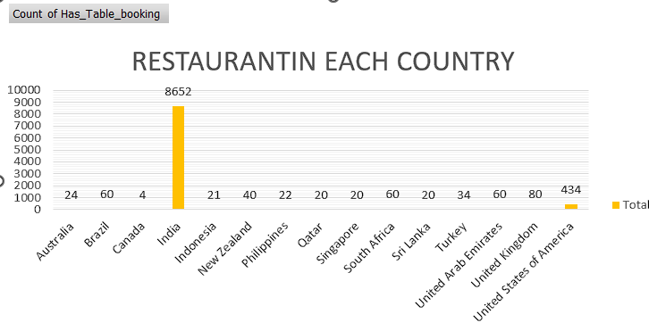
ANALYSIS
Information:
India has the highest number of restaurants, followed by the United States of America with the second highest count.
Canada has the least number of restaurants, with only 4.
Finding:
This information was easily obtained using a Pivot Table and its Column Chart, enabling a clear comparison of restaurant distribution across the 15 countries.
Key Insight:
The key takeaway is that this analysis provides valuable insight into which countries have the greatest restaurant presence, helping in identifying potential markets for opening new restaurants.

Slide 9
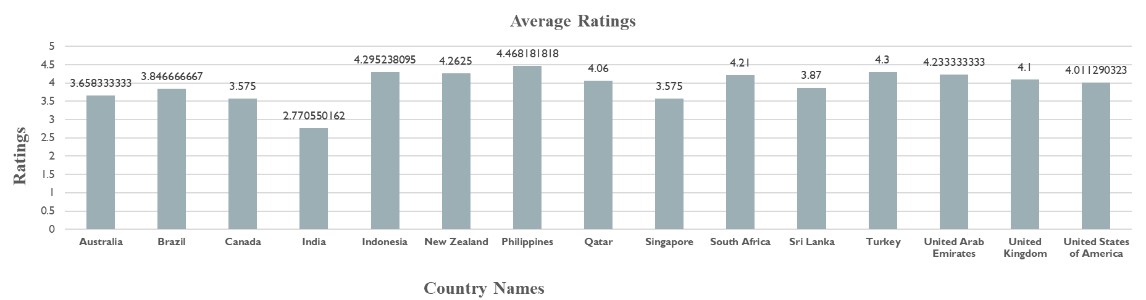
Customer View
Findings:
Philippines leads all countries in terms of average restaurant ratings, outperforming others.
India on the other hand, ranks at the bottom of the list with the lowest average ratings.

Slide 10
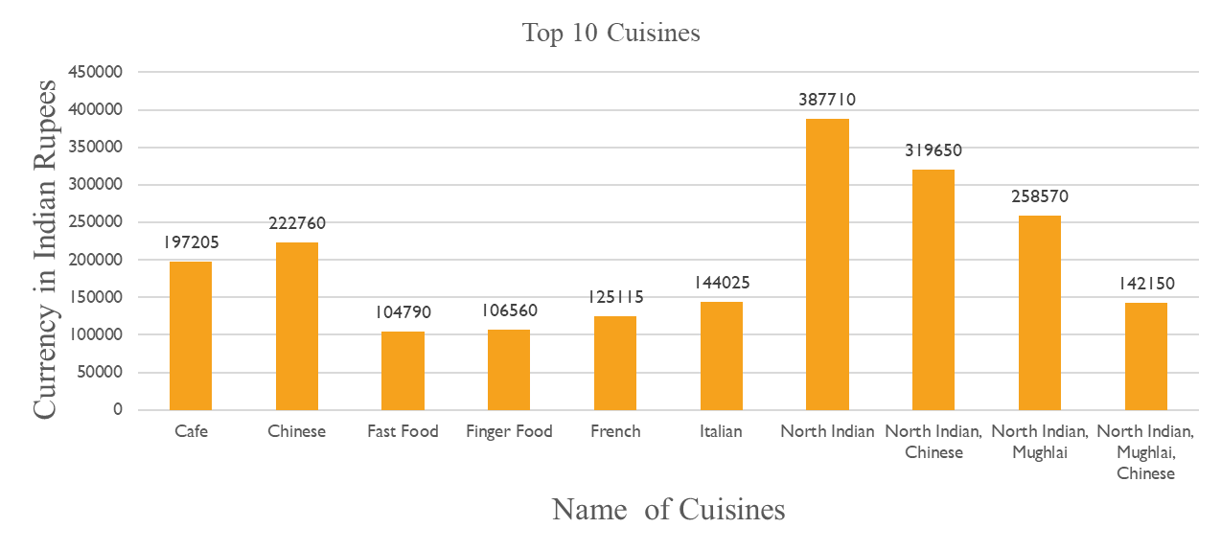
Analysis of Cuisines
North Indian cuisines rank at the top based on the average cost for two in Indian Rupees.

Slide 11
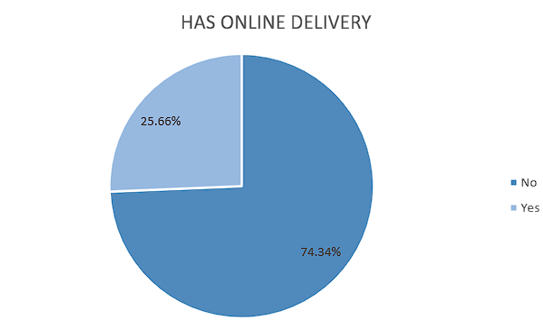
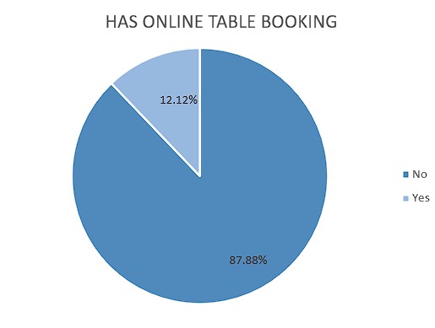
Types of Bookings
55% of restaurants offer table bookings, while the remaining 45% do not provide this service.
54% of restaurants have online bookings, whereas 46% do not offer online booking options.

Slide 12
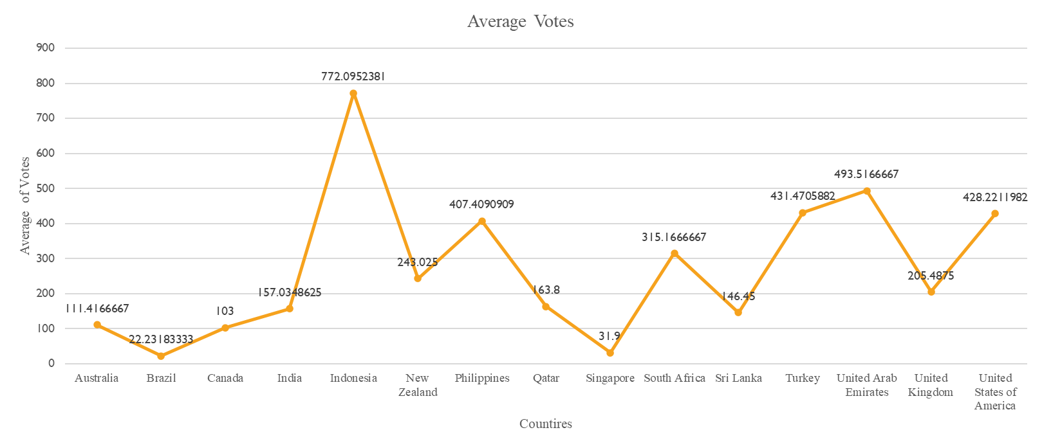
Countries Demanded on basis of votes
Indonesia is the only country to surpass the average threshold of 500 votes, achieving the highest number of average votes globally and outperforming all other countries.

Slide 13
Distribution of number of restaurants among different price in all countries
Different countries exhibit varying numbers of restaurants across different price ranges.
India leads with the highest number of restaurants across all price ranges.
Countries like the United States, United Kingdom, and South Africa show a more balanced distribution across price ranges but have significantly fewer restaurants compared to India.
Nations such as Indonesia, Sri Lanka, and Qatar have the fewest restaurants across all price ranges

Slide 14
Country selection for opening a new restaurant
The United Arab Emirates has only 60 restaurants. These numbers are significantly lower than in other countries, such as India, with over 8,600 restaurants.
Singapore has 20 restaurants, reflecting a balance between online and table bookings and relatively high customer satisfaction.
The United Kingdom has 80 restaurants with an average rating of 4.01, reflecting a balance between online and table bookings and relatively high customer satisfaction.

Slide 15
Country wise expenditure
Countries such as India, Indonesia, and Turkey have the lowest expenditure costs, making them more affordable dining destinations.

Slide 16
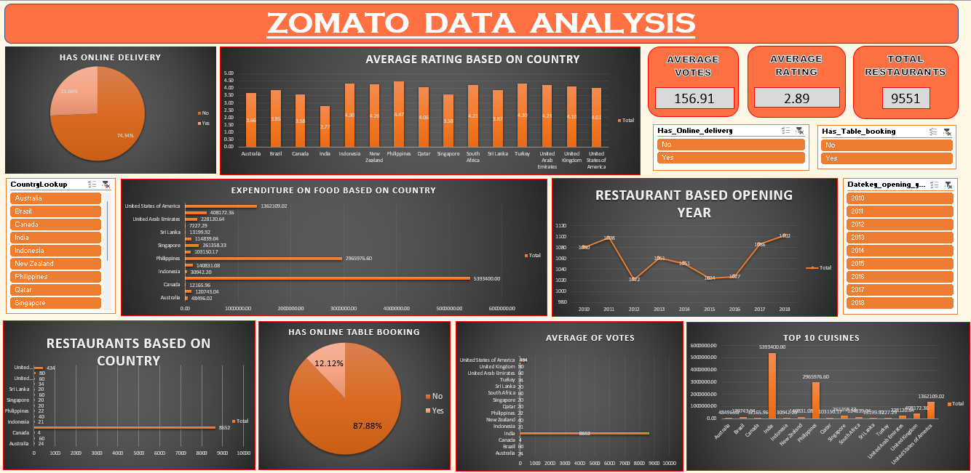
DASHBOARD

Slide 17
Recommendation For Opening New Restaurants
United Arab Emirates
Sharjah - Near New City Center Supermarket, Abu Shagara, Sharjah
Singapore
Singapore - 803 Raffles Avenue, #01-15 Esplanade Mall 039802
United Kingdom
Birmingham - 1 Canal Square, Brindleyplace, Birmingham B16 8EH

Slide 18

CONCLUSION
Our analysis of Zomato restaurant data uncovers significant opportunities for strategic global expansion. By focusing on regions with high demand, aligning offerings with demographic preferences, and leveraging competitive advantages, Zomato can effectively penetrate new markets. This approach will not only strengthen the company’s market presence but also provide exceptional dining experiences, fostering sustainable growth and enriching the global culinary ecosystem.

Slide 19
RECOMMENDATIONS
Leverage Multi-Cuisine Appeal:
Zomato should capitalize on its multi-cuisine offerings to cater to diverse customer tastes, broadening its appeal across various demographics.
Focus on Untapped Markets:
Countries such as Canada, Qatar, and the United States of America represent underpenetrated markets with significant potential for growth and market expansion.
Adapt to Customer Spending Trends:
Customers are willing to spend more based on their preferences, offering Zomato an opportunity to align pricing strategies with consumer demand.
Enhance Online Delivery and Table Booking Services:
Data shows that restaurants offering online delivery and table booking consistently achieve higher ratings, emphasizing the importance of investing in these services.
Cuisine-Driven Market Strategy:
Zomato’s approach to cuisine selection should align with the financial capacities and strategic goals of stakeholders, ensuring tailored investments and maximizing the potential for success in target markets.

Slide 20
THANK YOU

